Slide 1
Everyday Static Code Analysis
Václav Pech
Software Developer, Technology Evangelist
JetBrains, s.r.o.
vaclav@jetbrains.com

Slide 2
Professional software developer for 11 years
Consultant
Open source software author
Technology evangelist at JetBrains
JetBrains Academy member

Slide 3
All the bugs out there
Static Code Analysis
Tools available + IDE integration
Big Boy Toys
- custom patterns
- annotations

Slide 4
After this session you will know:
the principles of Static Code Analysis
the tools available
when and how to use them

Slide 5
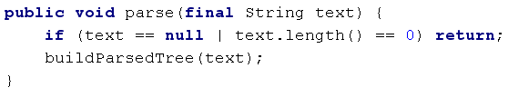
Sample 1

Slide 6
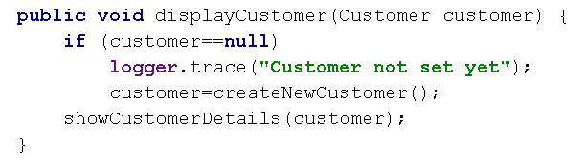
Sample 2

Slide 7
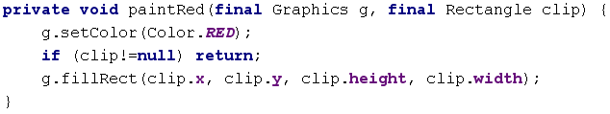
Sample 3

Slide 8

Know your enemy
Bad practice
Correctness
Internationalization
Malicious code vulnerability
Multithreaded correctness
Performance
Code style violations
Dodgy
    (Bill Pugh, FindBugs)
Notes:
We all make stupid mistakes

Slide 9
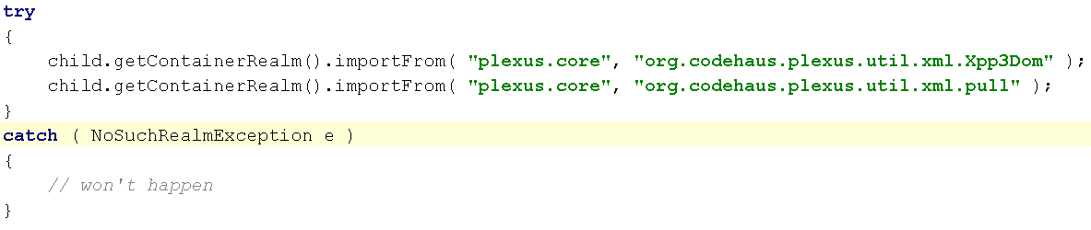
Bad practice

Slide 10
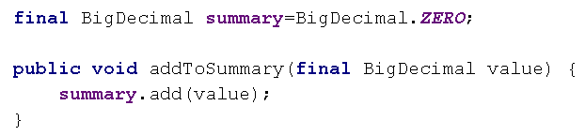
Correctness

Slide 11
Internationalization

Slide 12
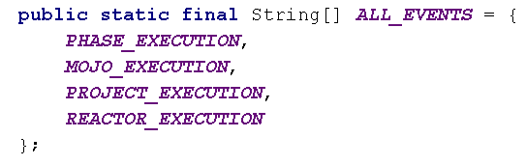
Malicious code vulnerability

Slide 13
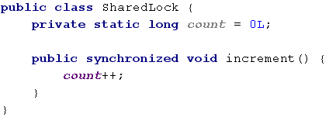
Multithreaded correctness

Slide 14
Performance

Slide 15

Code style violations

Slide 16
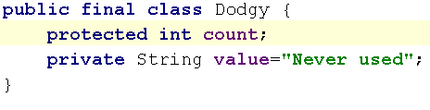
Dodgy

Slide 17
Tools
Debugger
Profiler
Unit tests
Code revisions
  Formal revisions
  Pair programming
Static code analysis

Slide 18
Static Code Analysis
On demand
On the fly
Notes:
On demand - IDE, cmd, CI

Slide 19
Static Code Analysis
Searches AST for bug patterns
Source code or byte-code

Slide 20
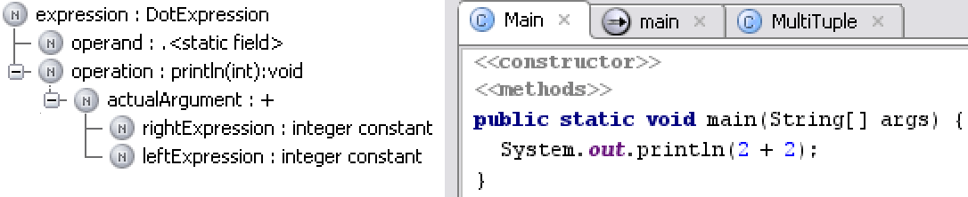
Abstract Syntax Tree
Notes:
class Example { void bar() { while (baz) buz.doSomething(); } }

Slide 21
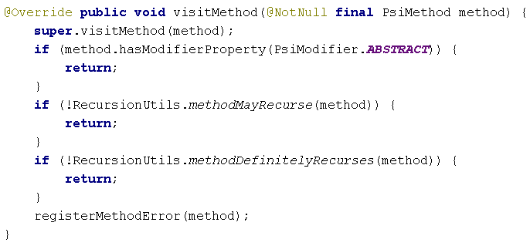
Infinite recursion detection

Slide 22
Advanced capabilities
Quick fixes
Profiles
Suppressing false positives
Custom patterns
Duplicate detection

Slide 23
IntelliJ IDEA
Tight IDE integration
700 bug patterns
Non-Java code too
Suppressing false positives
Dependency and duplicate analysis

Slide 24

FindBugs
Byte-code analysis
Almost 400 bug patterns
Plugins for all IDEs

Slide 25

CheckStyle
About 100 bug patterns
Focused on style issues
Duplicate detection
Plugins for all IDEs

Slide 26

PMD
More than 200 bug patterns
Duplicate detection
Suppressing false positives
Plugins for all IDEs

Slide 27
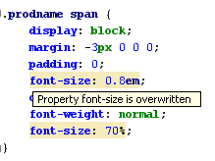
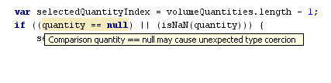
There’s more than Java out there
JavaScript
CSS, HTML, XML
GWT, Struts
EE, ME

Slide 28
Create your own bug patterns
Define
  an AST sub-tree to search for
  an AST sub-tree to replace it with

Slide 29
Helper annotations - JSR 305 & 308
@Nullable, @NotNull, @Nls, @NonNls
@PropertyKey, @Pattern, @Language
@Nonnegative, @Signed
@Tainted, @Untainted
@ThreadSafe, @GuardedBy

Slide 30
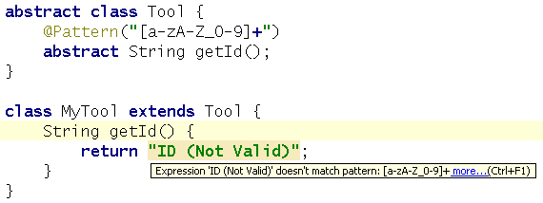
@Pattern

Slide 31
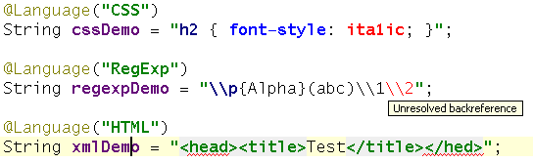
Language injection

Slide 32
Summary
Select a tool
Integrate into IDE
Select the patterns
Add your own ones
Run it automatically on CI

Slide 33
Questions

Slide 34
Session Evaluation
Please complete a session evaluation and turn it into any conference staff member or at the registration desk. Thank you.

